Slide 1

HARRY POTTER
Analyzing and Classifying Harry Potter Data
Information Retrieval Project
Abhishek Bargujar, Martin Kafka
WS 2024/2025

Slide 2

Introduction
Motivation: Interest in Harry Potter's rich universe and textual data as a study case
Objective: Develop an efficient system for textual information retrieval
Techniques: Query expansion, document ranking using TF-IDF and Cosine Similarity
Notes:
The motivation for this project stemmed from the richness of the Harry Potter universe, which provides a diverse set of textual data, including dialogues, spells, and potions. Our objective was to create an efficient information retrieval system, leveraging techniques learned during the course. We aimed to explore methods like query expansion and document ranking to address real-world IR challenges.

Slide 3



Project scope
Data collection and cleaning
Preprocessing
Query expansion
Document ranking
Interactive app
Libraries used: NLTK, scikit-learn, Flask
Notes:
Our methodology followed a clear workflow starting from data collection and cleaning, followed by text preprocessing to standardize the input. Query expansion was implemented using bigrams and TF-IDF to improve recall, and document ranking was performed using Cosine Similarity and the Binary Independence Model. Finally, an interactive application was developed using Flask. Key libraries used include NLTK, scikit-learn, and Flask for these stages.

Slide 4
Data collection and cleaning
Data collection:
Kaggle
Corpus for first 3 movies, potions, spells in CSV
Data cleaning:
Standardizing columns names – lowercase, no space
Filling missing values
Normalizing the text - removing special characters and punctuation – using „re“ library
Notes:
We collected datasets from Kaggle, which included dialogues from the first three Harry Potter movies, along with detailed descriptions of spells and potions. Cleaning this data was crucial for consistent processing. For instance, we standardized column names, handled missing values by replacing unknown data with placeholders, and removed special characters to normalize the text for further analysis.

Slide 5

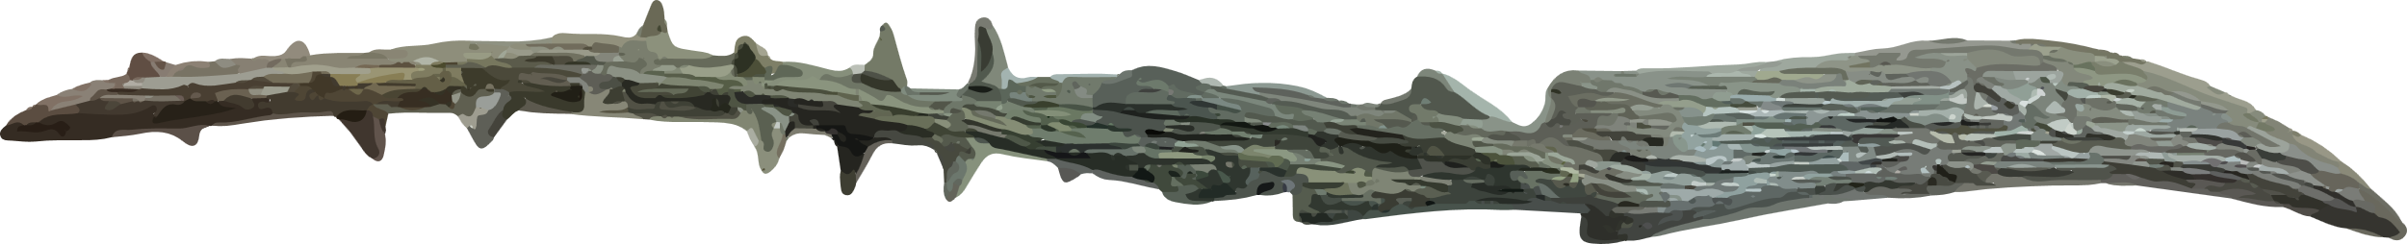
Text preprocessing
Tokenization: „Harry Potter“ → [„Harry“, „Potter“]
Stop words removal: Removing „the“, „and“, etc.
Stemming: „running“ → „run“
Lemmatization: „better“ → „good“
Text normalization: Lowercase, punctuation, extra spaces
Libraries used: NLTK for tokenization, stop word removal, stemming, lemmatization and re for regex-based text cleaning
Notes:
Preprocessing is a crucial step in any information retrieval system to standardize the data. We started with tokenization, splitting sentences into words, and removed stop words to retain meaningful terms. Then, we used stemming to reduce words to their roots and lemmatization to further refine the base forms while preserving grammatical context. Finally, text normalization ensured consistency in format. Tools like NLTK and regular expressions helped implement these techniques effectively.

Slide 6

Query expansion
Traditional approach
Modern approach
Generated bigrams by using sliding windows
Indexed bigrams for query suggestion – „Google autocomplete“
Ranked docs using TF-IDF and Cosine similarity
Explore embeddings
Using pre-trained transformer from Hugging face: all-MiniLM-L6-v2
Retrieving most related sentences from a query
Library used for embeddings: sentence-transformers
Notes:
For query expansion, we explored two approaches. The traditional method relied on bigrams, generated through sliding windows, which were indexed and ranked using TF-IDF and Cosine Similarity. While efficient for simple queries, this method had limitations for complex queries. To address this, we also explored semantic matching using embeddings generated by pre-trained transformer models. This provided a more context-aware retrieval mechanism, especially for ambiguous queries.

Slide 7

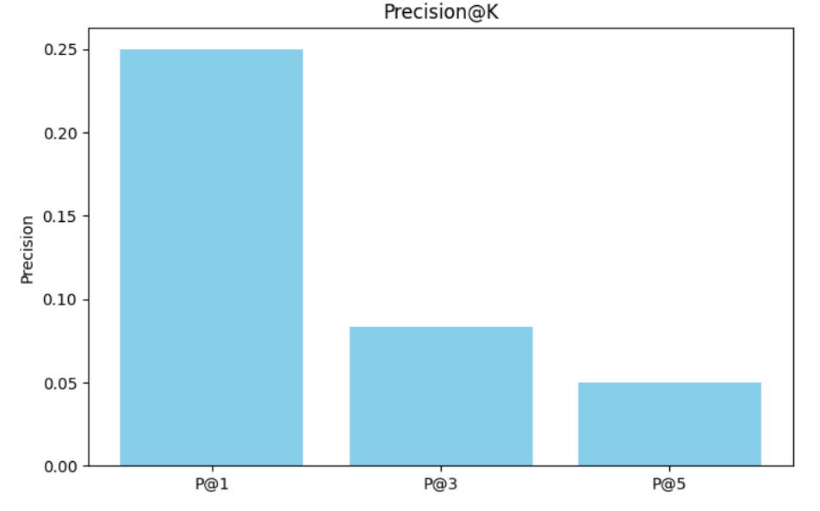
Information Retrieval Results
Precision@K – sharp drop for higher K
Mean Reciprocal Rank: 0.25
Struggled with large results set
- not giving an answer for a query „magic“
Notes:
To evaluate the retrieval system, we used metrics like Precision@K and Mean Reciprocal Rank. The traditional approach, which relied on bigrams and TF-IDF, performed well for straightforward queries but struggled with larger result sets. For instance, Precision@1 was 0.25 but dropped sharply for higher K values. In contrast, the semantic approach, leveraging embeddings, excelled at retrieving contextually relevant results, making it more suitable for complex or ambiguous queries.

Slide 8
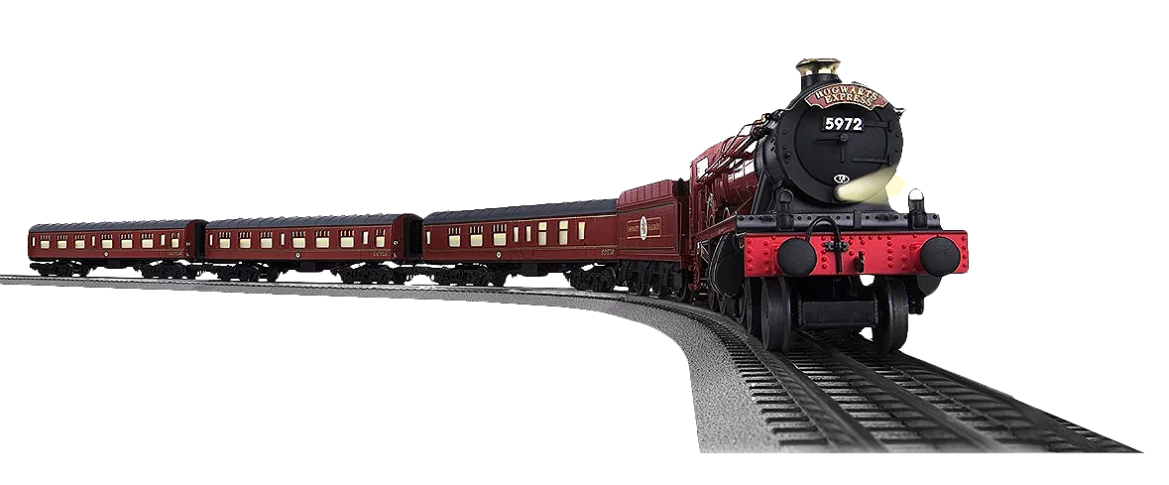
Comparison of Retrieval Methods
In both approaches, we are achieving something different but generally:
Traditional approach
Simpler idea – just a recommendation of next word
Lot of work on data cleaning
Not even that efficient – sparsity, class imbalance
Modern approach
Simple to use – just embeddings and transformer
Retrieving good results
Could be computationally expensive

Slide 9
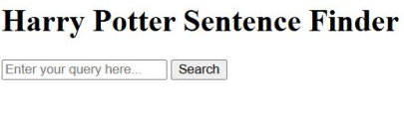
Interractive application
Flask framework – basic interface
Made for the modern approach with transformer
Query handling with integrated TF-IDF and transformer-based embeddings

Slide 10

Memory requirements
Traditional approach need more memory to store corpus and inverted index & for one csv it need 5+ MB (approx.)
Transformers approach needs very little memory because we store sentences as corpus and inverted index all things go to Transformers, It takes less time
Traditional approach need GPU to run the ipynb file fast and better Transformers need less time to run; we can use the CPU only

Slide 11

Limitations and future ideas
Limitations
Future work
Restricted data for first 3 movies
Bigram expansion struggled
Simple interactive application
Expand datasets
BERT for Improve UI of application
working with larger datasets

Slide 12
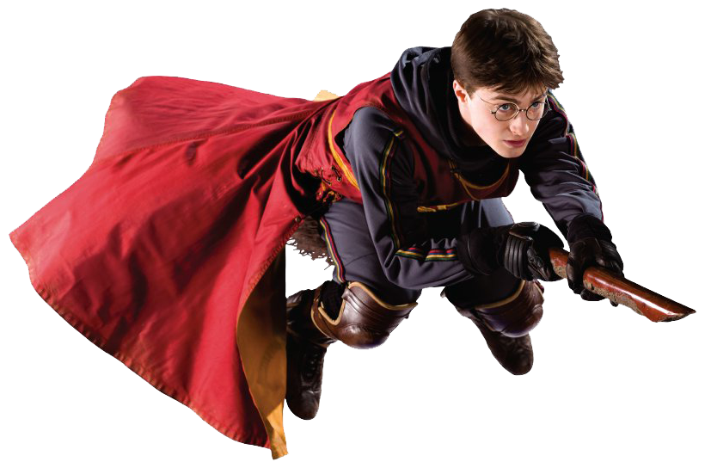
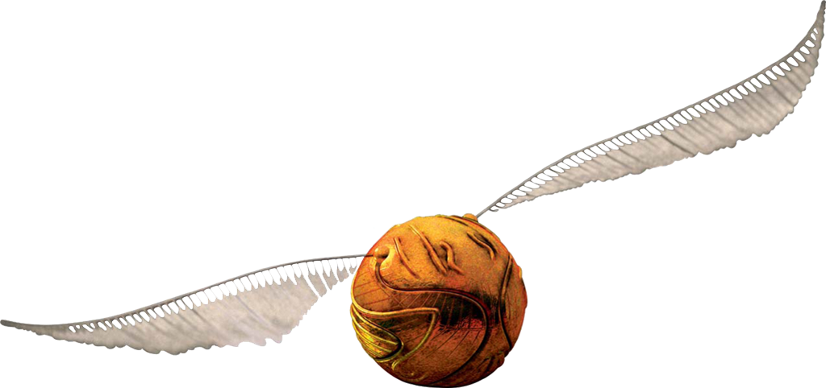
Conclusion
Developed a retrieval system using traditional and modern approach
Interactive application
Strength and Limitations
Notes:
In conclusion, we successfully developed an information retrieval system using both traditional and semantic methods. The project highlighted the strengths and limitations of these approaches, emphasizing the importance of choosing the right technique based on the dataset and query complexity. Our interactive application demonstrated these retrieval capabilities, combining simplicity and advanced techniques for a robust solution to diverse information retrieval challenges.

Slide 13

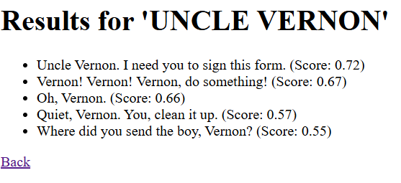
App demo
Let‘s have a look on our app

Slide 14
Q and A
Thank you for your attention! Do you have any questions?

Slide 15
THANK-YOU

